Slide 1
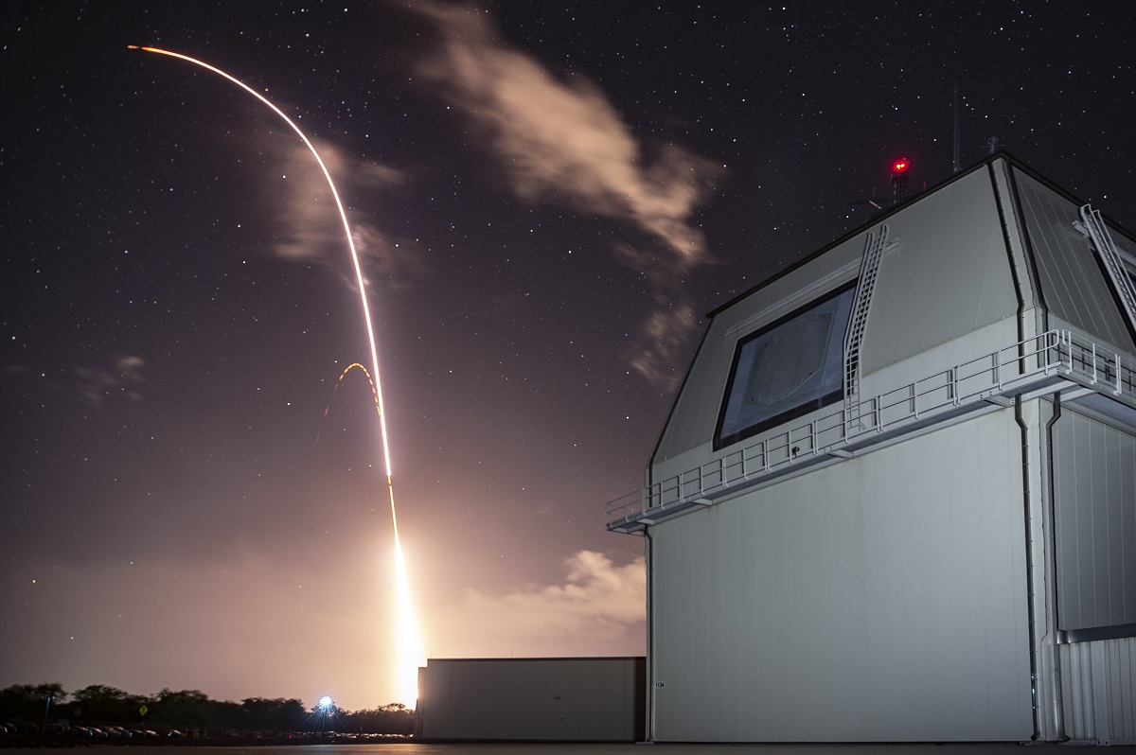
CDE 2605R Research project on drone detection radar
By: Ang Ding Li Victor, Weng Xian Yang, You Qi Xuan

Slide 2
Project objectives
6/3/26
Gain an understanding of radar fundamentals
Gain experience with radar system design
Build a portable, phased array radar system, to detect UAS
Validate system by testing against live UAS
Write UREx report
Attend mandatory five workshops for all UREx fellows

Slide 3
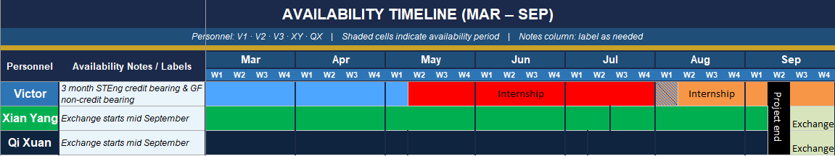
Timeline
6/3/26
Qi Xuan and Xian Yang need to end the project before going on SEP, expected to fly off end of week 1 September
Victor accepted STEng summer internship, attempting to apply as VIA, subject to CDE
Also accepted GlobalFoundries semester internship, flexible start and end date, will turn into IA if STEng VIA rejected
Both supervisors are aware of UREx, will attempt to accommodate so I have time to contribute even during internship

Slide 4
Deliverables plan
6/3/26
Victor to submit deliverables before VIA
In above case, will help out with UREx in unofficial capacity until project end
Will submit deliverables before IA In case of no VIA or SID internship, will help out until project end
Xian Yang and Qi Xuan deliverables must be submitted before SEP which is expected to start in middle of September
Soft deliverables such as report can be submitted before official start of SEP even after flying off to the USA
Deliverables
UREx report
Working radar set
Documentation for radar set

Slide 5
Starting off
6/3/26
Given lack of background knowledge, all members to read Radar Fundamentals textbook provided by prof Koenraad
Chapters that we think will be relevant to project:
Ch 1-8, 10, 13-14
Radar set's main goal is to detect potential UAS targets only, so chapter on tracking not relevant
Telegram chat?
To conduct a literature review on current C-UAS radar systems
Look up existing projects to find limitations and tradeoffs
See if there can be improvements made to current systems

Slide 6
Literature survey
6/3/26
Found out that systems mentioned in academic papers typically have a few hundred metres range
Vs the few km range for defence solutions e.g echodyne/kongsberg
One area to explore can be how these systems differ and how they are designed to achieve a much higher instrumented range

Slide 7
Radar specifications (tentative)
11/02/2025
The system should be able to detect a commercial quadcopter drone sized target out to x distance away
Frequency band: X?
Range: 1km??
Configuration: 1 panel should be fine

